Slide 1
Signal and System
Studies in the time domain
Name-Aishika Das Name-Priya Singh Name-Neeharika Sharma
Enrollment no.-2021CSB074 Enrollment no.-2021CSB057 Enrollment no.-2021CSB106

Slide 2
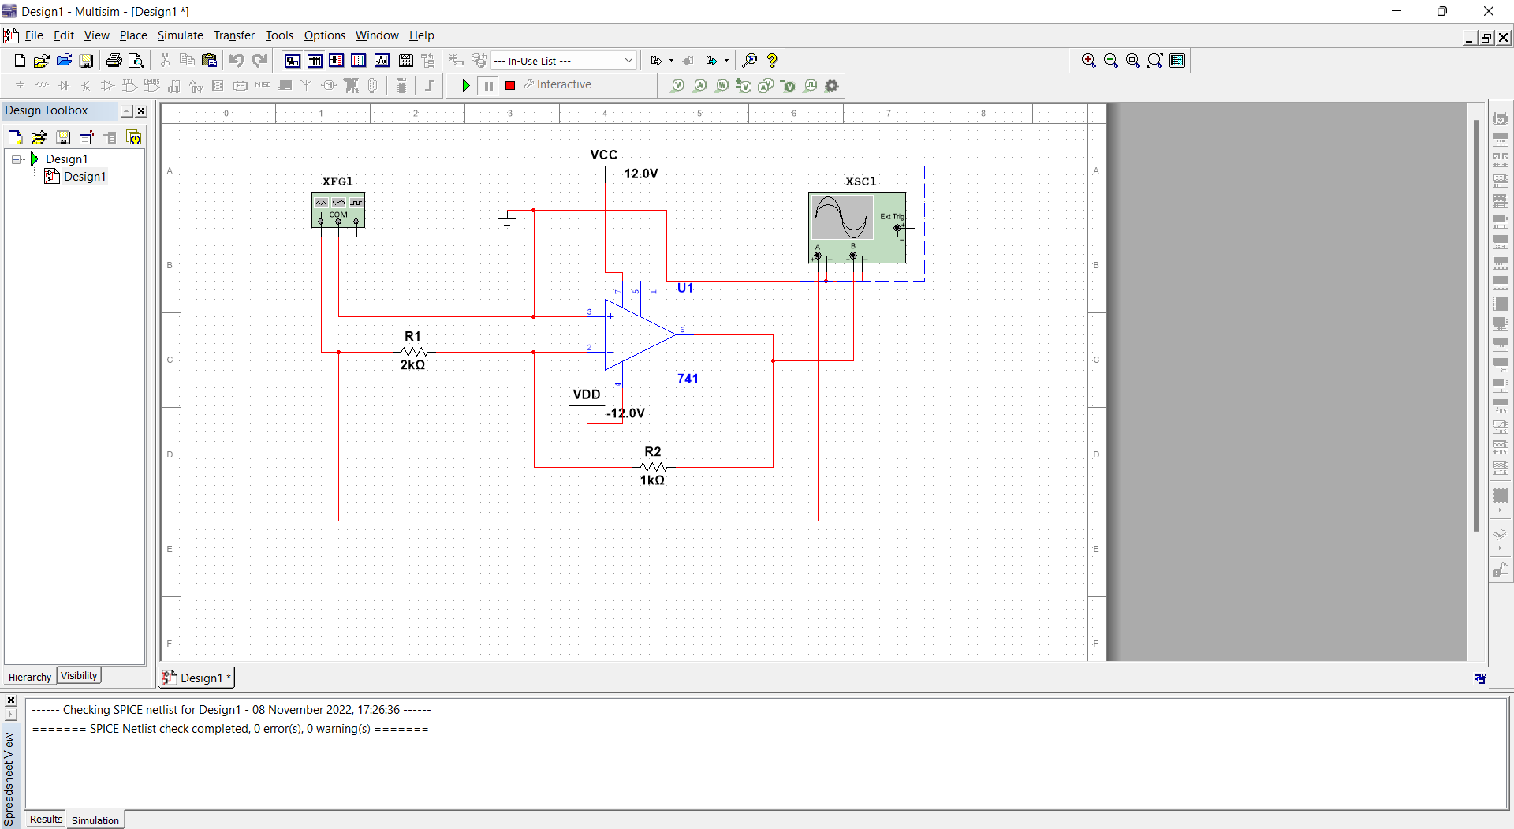
Part-A
Aim: Implementation of a simple inverting amplifier and to check whether the gain (Vout/Vin) remains linear over a range of input voltage and to plot the gain against a swing or profile of input voltage for this.
Circuit:

Slide 3
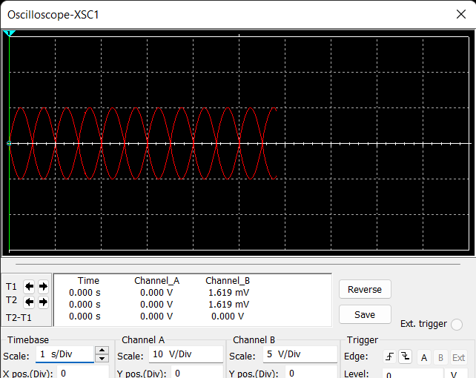
Stimulation:
Frequency:1kHz
Amplitude:10Vp

Slide 4
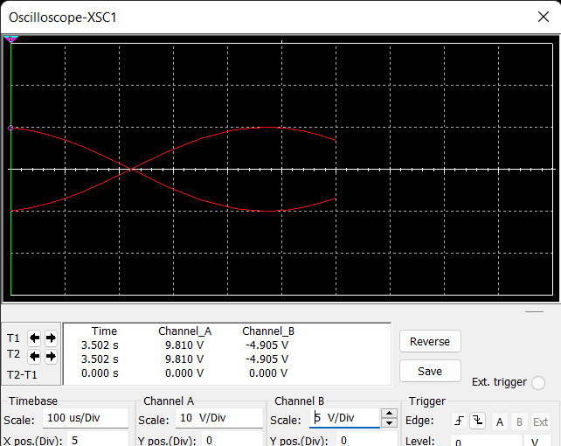
Frequency:1Hz
Amplitude:10Vp

Slide 5
Theory and Graph:
There are two very important rules to remember about Inverting
Amplifiers or any operational amplifier for that matter and these are.
• No Current Flows into the Input Terminals
• The Differential Input Voltage is Zero as V1 = V2 = 0 (Virtual Earth)
Then by using these two rules we can derive the equation for calculating the closed-loop gain of an inverting amplifier, using first principles. Current ( i ) flows through the resistor network as shown.

Slide 6
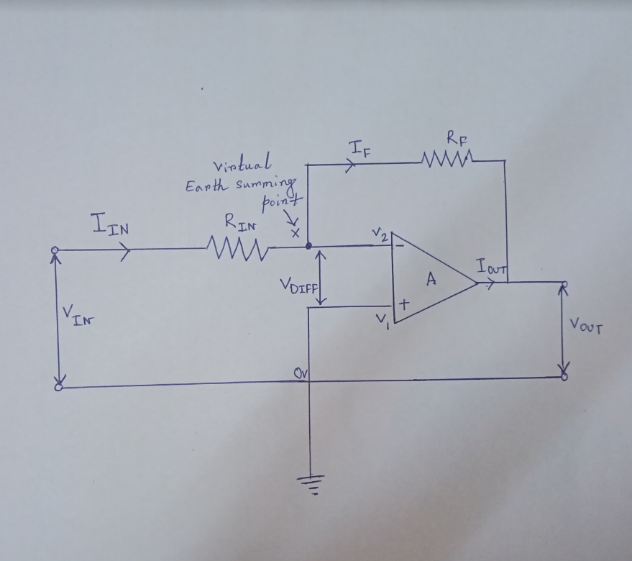
Diagram:

Slide 7
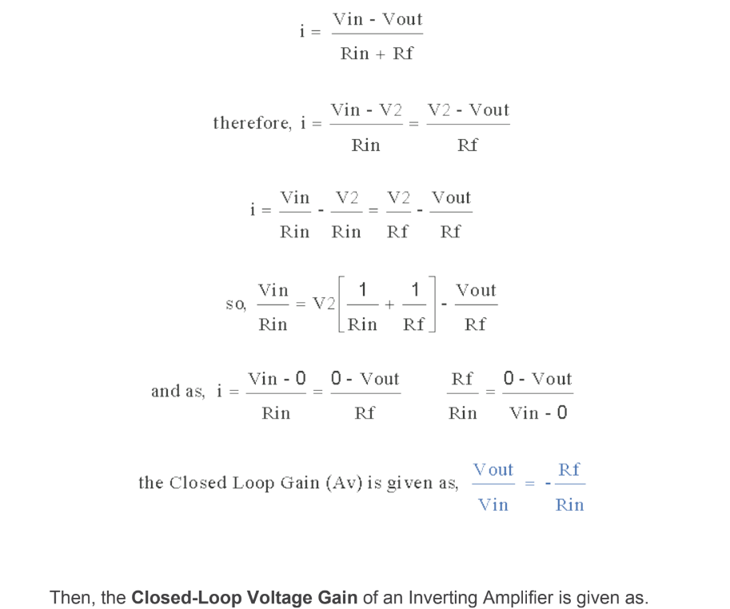

Slide 8
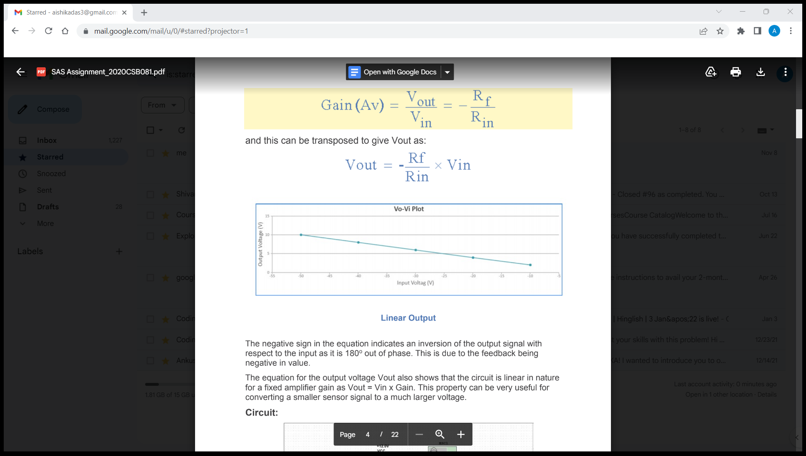
Graph Vout vs Vin:

Slide 9
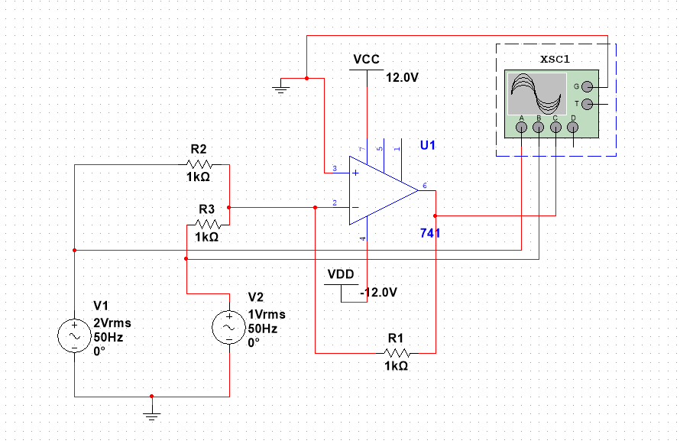
Part-B
Aim: We have to implement a few designs that produce a linear combination of two or more input voltage signals at the output and we have to check different alternatives like sum and differences.
Circuit:
Summing Amplifier

Slide 10
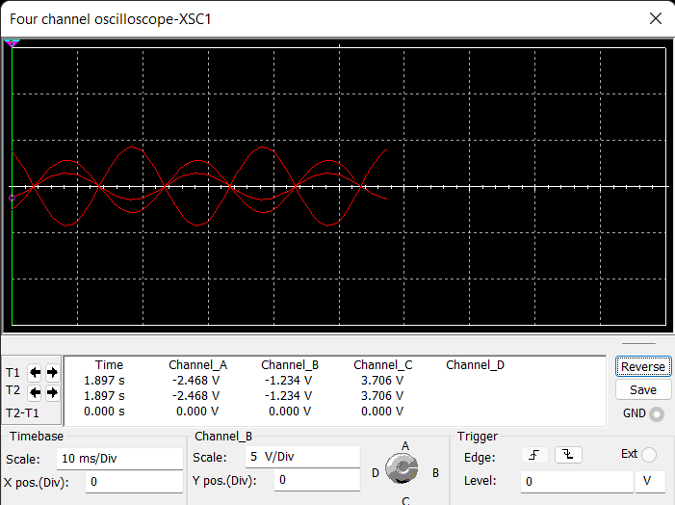
Stimulation:
Frequency:50Hz
V1:2Vrms
R1:2kohm

Slide 11
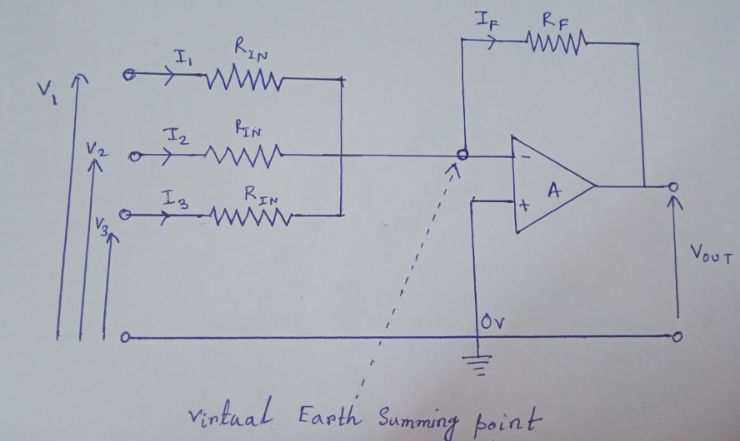
Diagram:

Slide 12
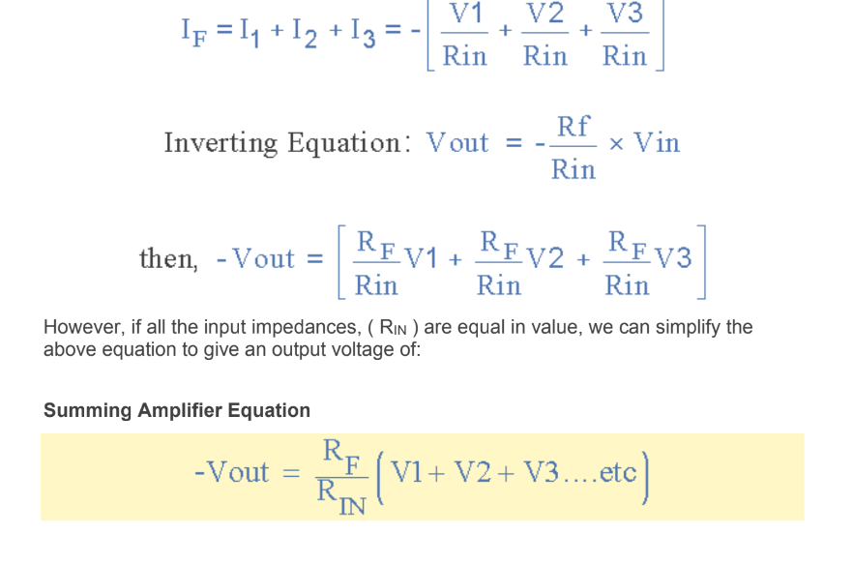
Theory: In this simple summing amplifier circuit, the output voltage, ( Vout ) now becomes proportional to the sum of the input voltages, V1, V2, V3, etc. Then we can modify the original equation for the inverting amplifier to take account of these new inputs thus:

Slide 13
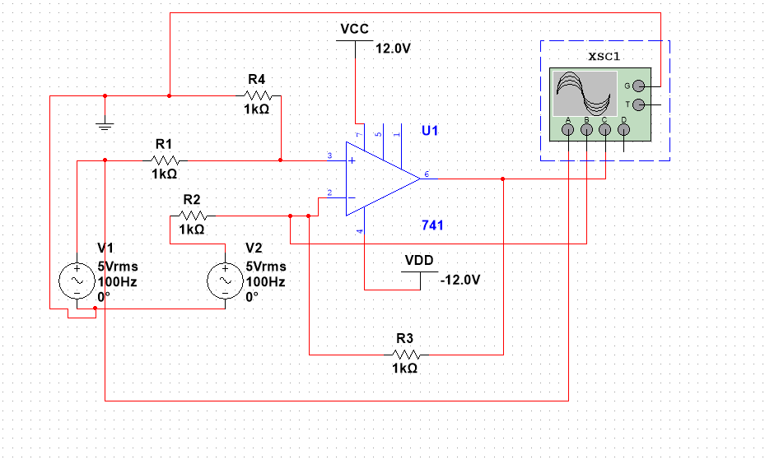
Differential circuit:

Slide 14
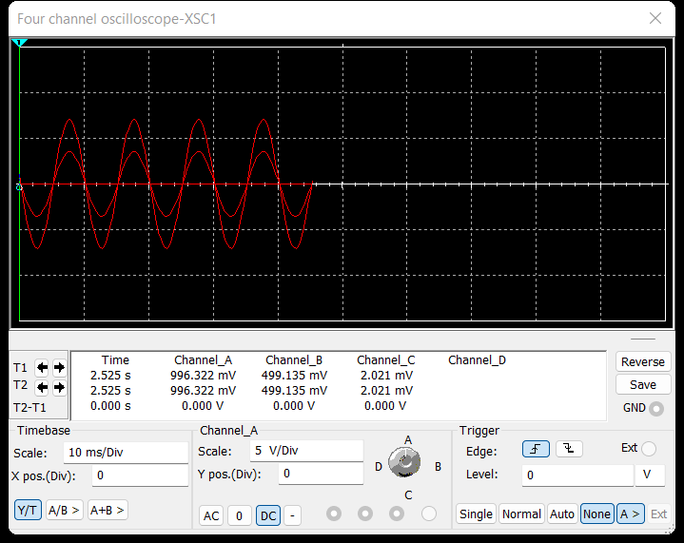
Stimulation:
Frequency: 100Hz
V1 = 5Vpk
V2 = 3Vpk

Slide 15
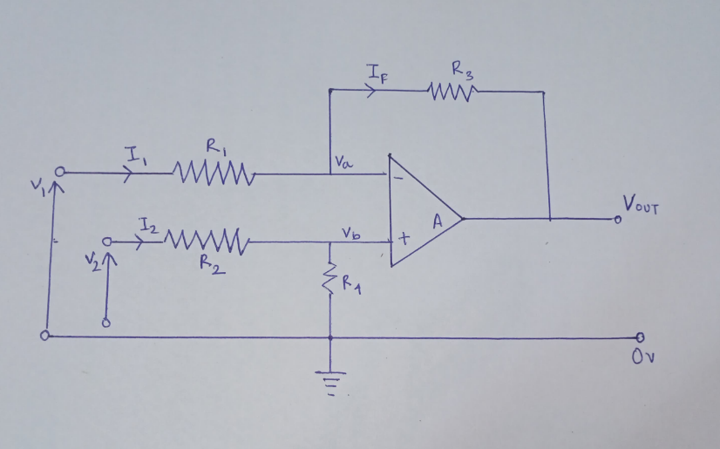
Theory:
The differential amplifier amplifies the voltage difference present on its inverting and non-inverting inputs. Then differential amplifiers amplify the difference between two voltages making this type of operational amplifier circuit a Subtractor, unlike a summing amplifier which adds or sums together the input voltages. This type of operational amplifier circuit is commonly known as a Differential The Amplifier configuration is shown below:

Slide 16
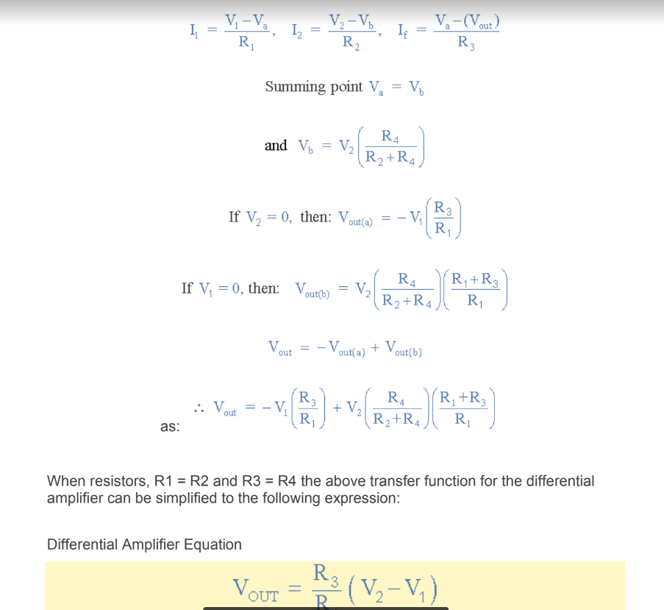
By connecting each input in turn to 0v ground we can use superposition to solve for the output voltage Vout. Then the transfer function for a Differential Amplifier circuit is given

Slide 17
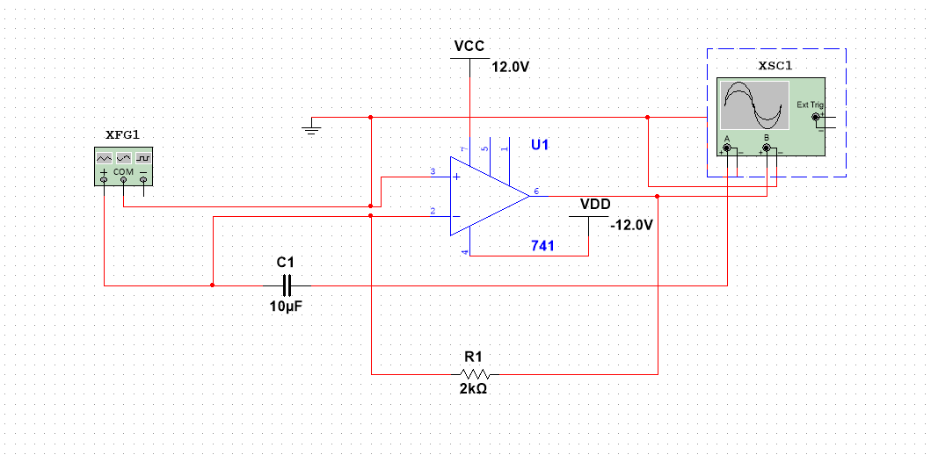
Part-C
Aim: We have to implement the integrator circuit and also the proportional + Integral(PI) circuit and we have to check the output for differentiator input voltage.
Circuit:

Slide 18
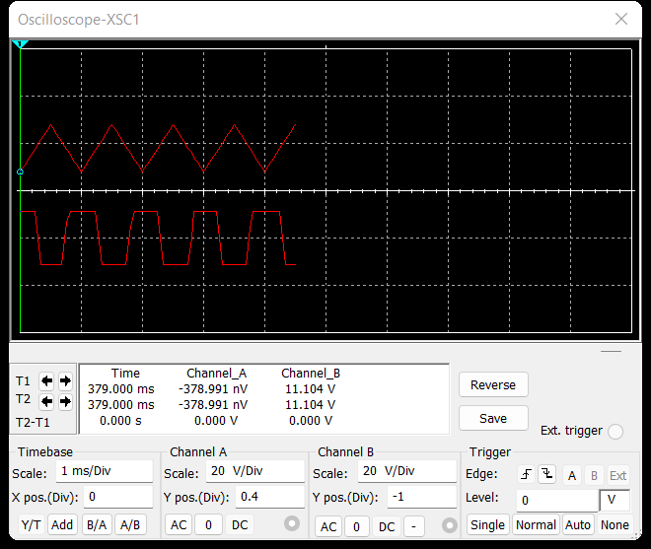
Stimulation:
Frequency:1Hz
Amplitude:10Vp

Slide 19
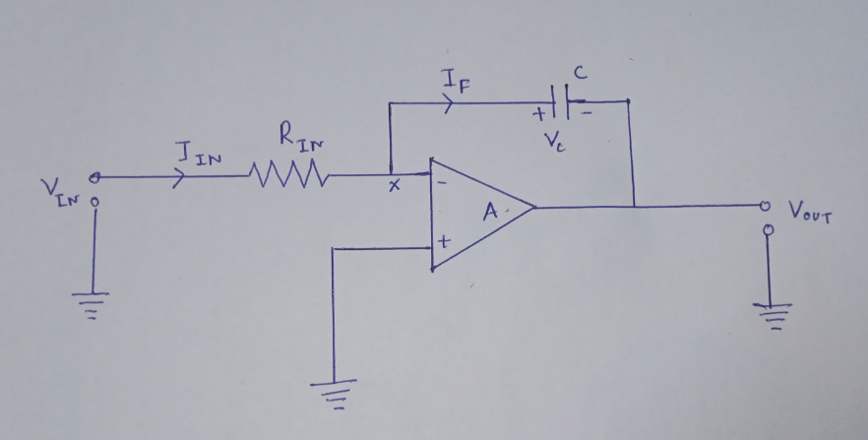
Theory: The integrator Op-amp produces an output voltage that is proportional to the amplitude and duration of the input signal. By replacing this feedback resistance with a capacitor, we now have an RC Network connected across the operational amplifiers feedback path producing another type of operational amplifier circuit commonly called an Op-amp Integrator circuit as shown below.

Slide 20
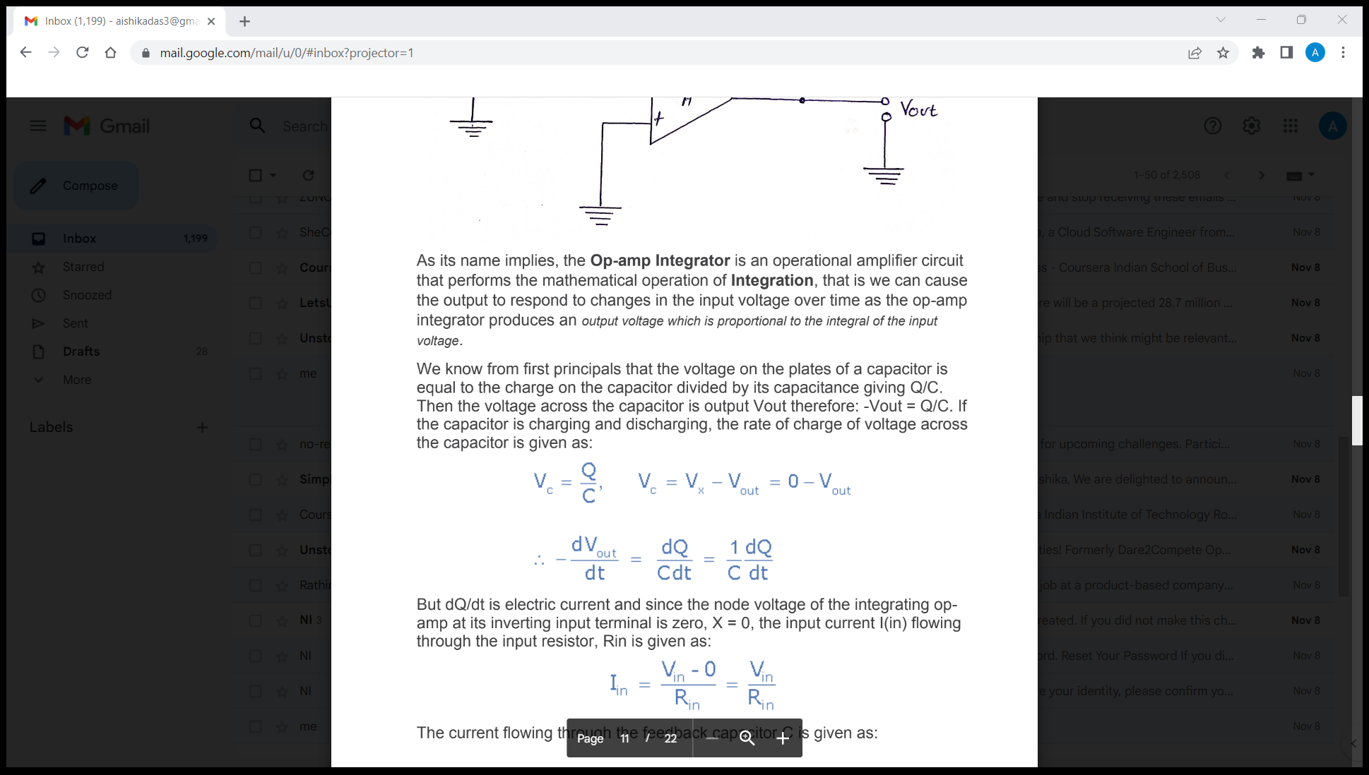
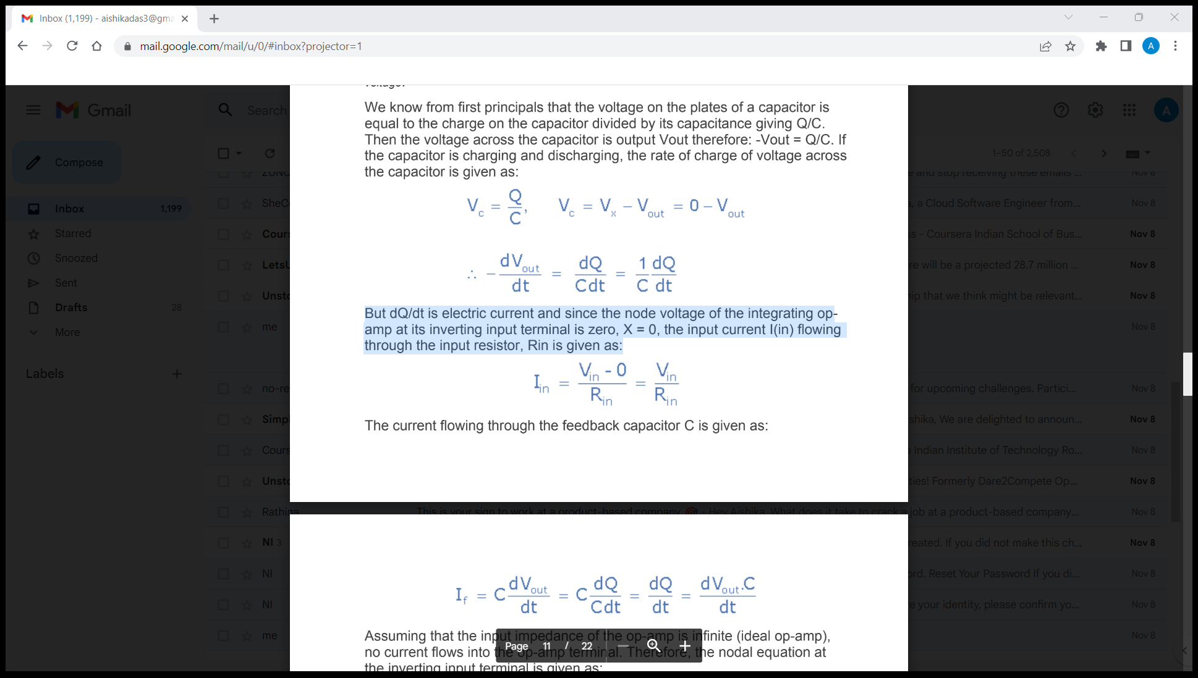
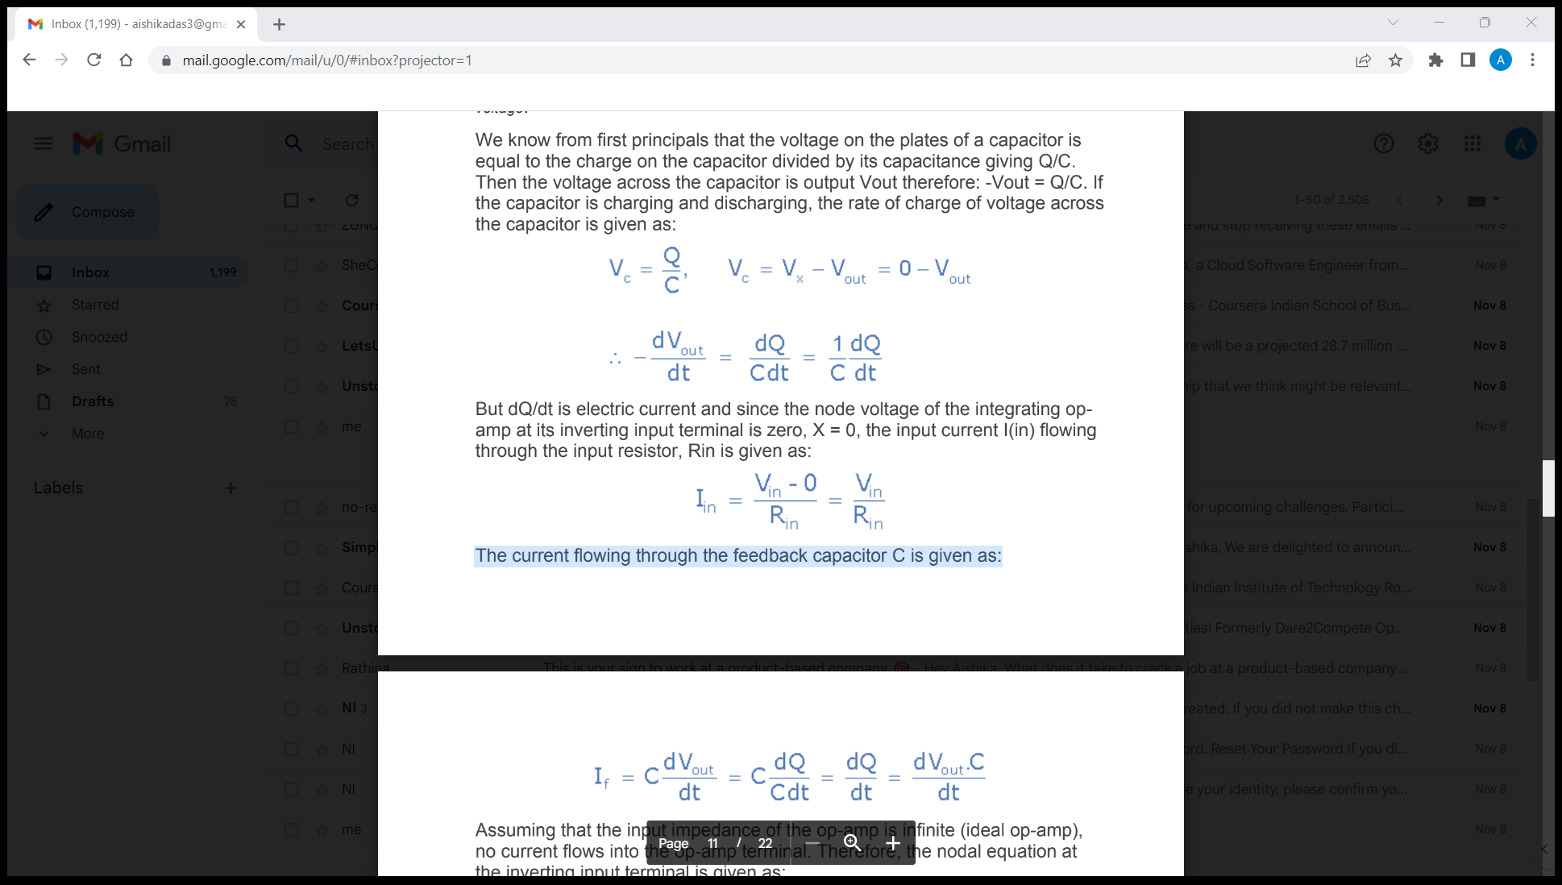
As its name implies, the Op-amp Integrator is an operational amplifier circuit that performs the mathematical operation of Integration, that is we can cause the output to respond to changes in the input voltage over time as the op-amp integrator produces an output voltage that is proportional to the integral of the input voltage. We know from first principles that the voltage on the plates of a capacitor is equal to the charge on the capacitor divided by its capacitance giving Q/C.Then the voltage across the capacitor is output Vout therefore: -Vout = Q/C. If the capacitor is charging and discharging, the rate of change of voltage across the capacitor is given as:
But dQ/dt is electric current and since the node voltage of the integrating op-amp at its inverting input terminal is zero, X = 0, the input current I(in) flowing through the input resistor, Rin is given as:
The current flowing through the feedback capacitor C is given as:

Slide 21
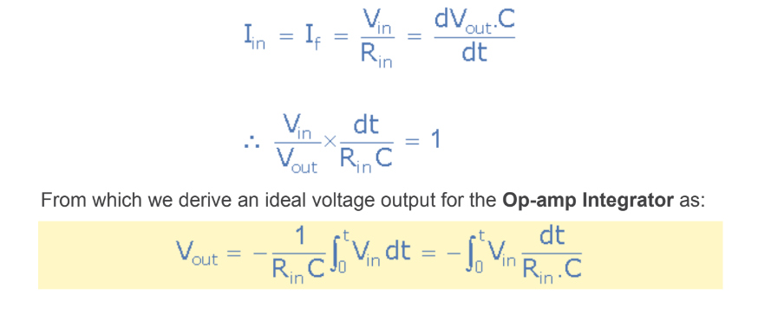
Assuming that the input impedance of the op-amp is infinite (ideal op-amp), no current flows into the op-amp terminal. Therefore, the nodal equation at the inverting input terminal is given as:

Slide 22
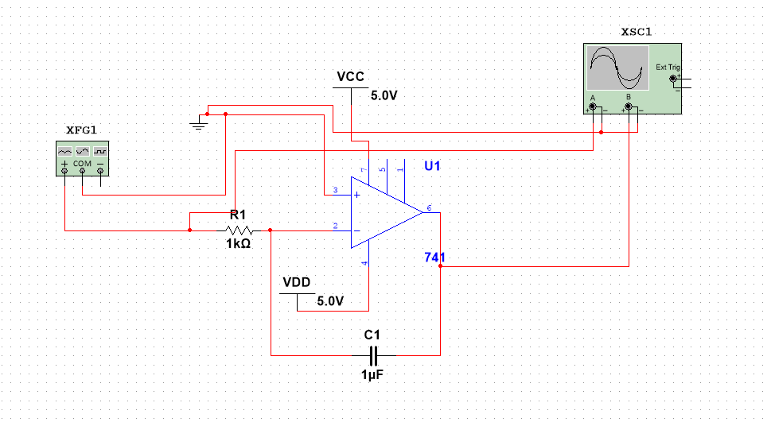
Circuit for PI:

Slide 23
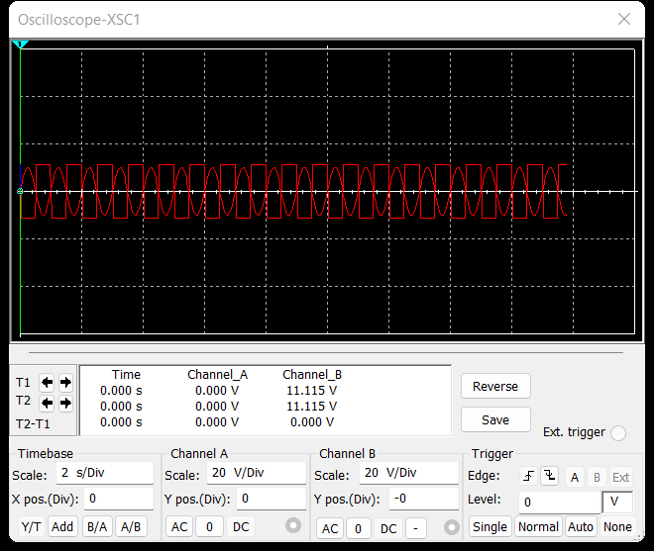
Stimulation(For sin waveform):

Slide 24
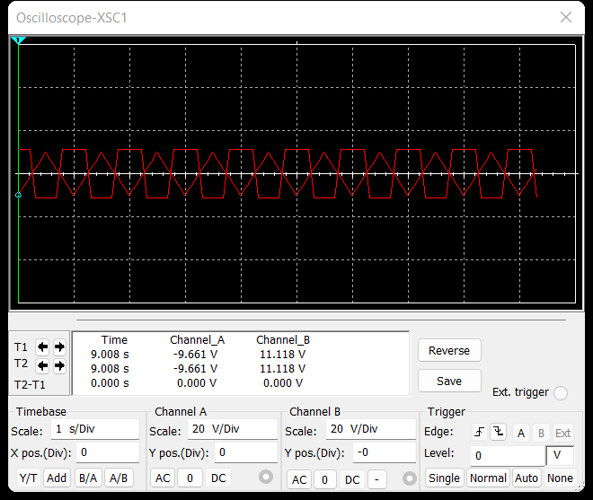
(For triangular waveform)

Slide 25
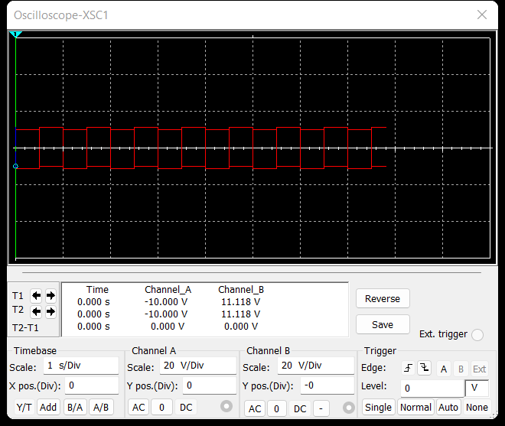
(For square waveform):

Slide 26
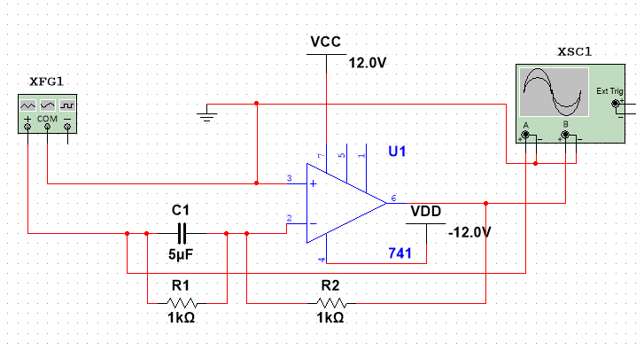
Part - D
Aim: Implement the differentiator circuit and also the Proportional+Integral+Derivative(PD) circuit. Check the output for different input voltage profiles alike in C above.
Circuit(PD):

Slide 27
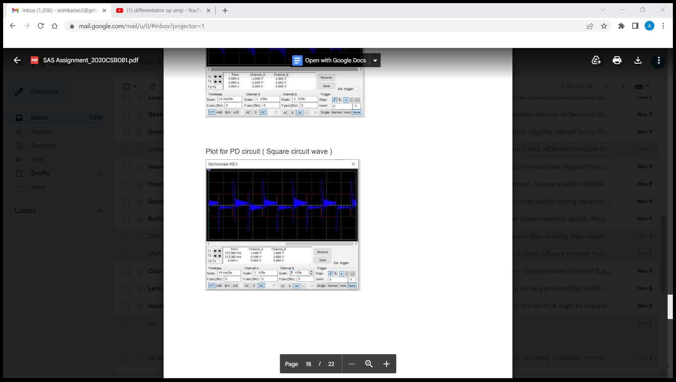
Stimulation(For Square wave):

Slide 28
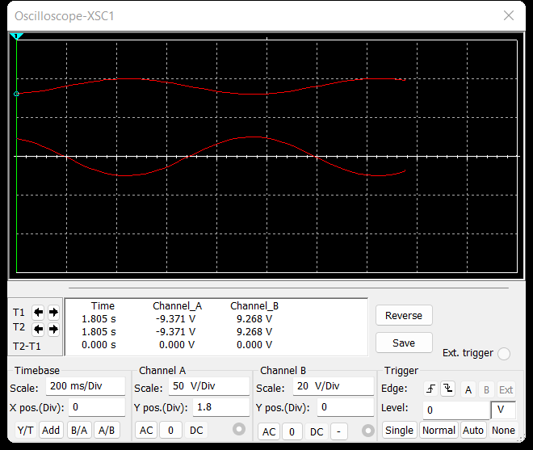
(For sin wave):

Slide 29
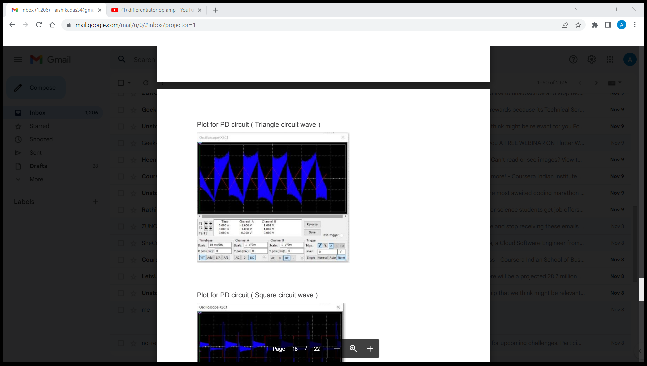
(For Triangular wave):

Slide 30
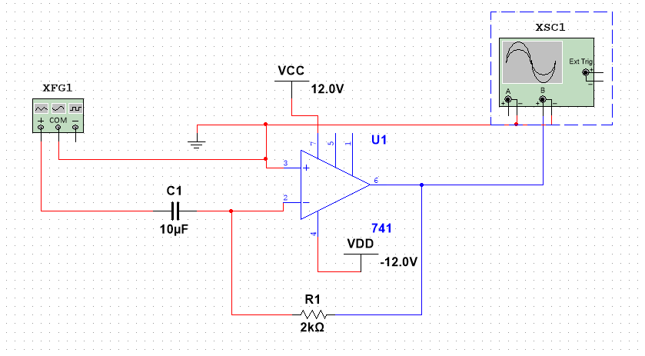
Circuit for Differentiator:

Slide 31
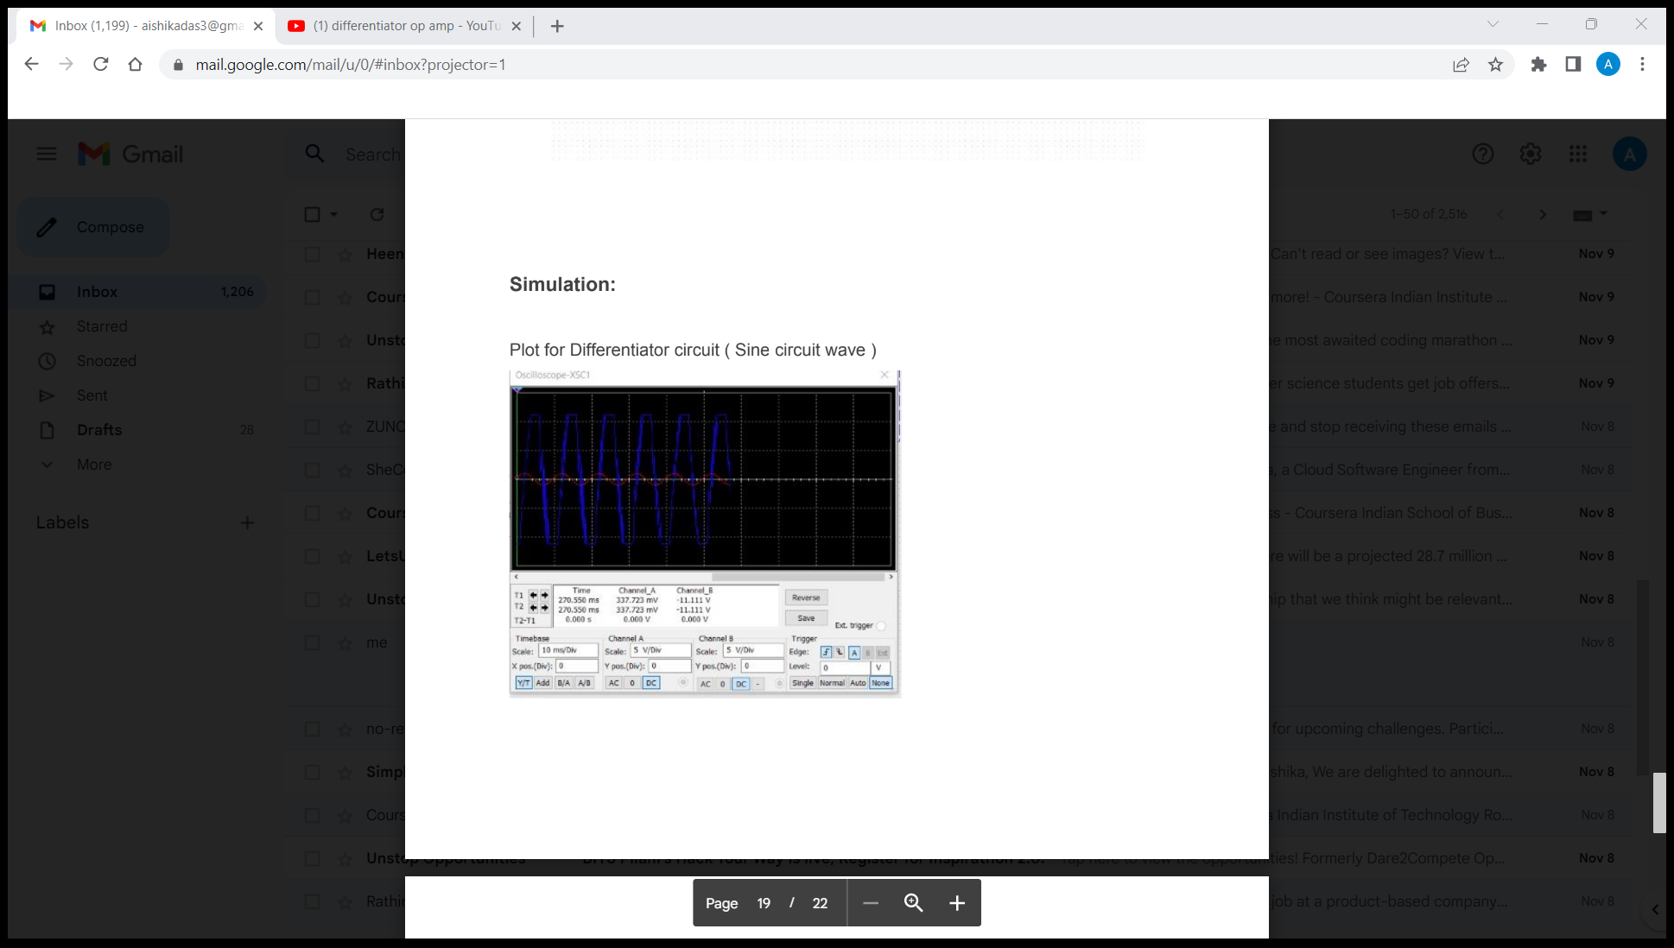
Stimulation(For sin wave):

Slide 32
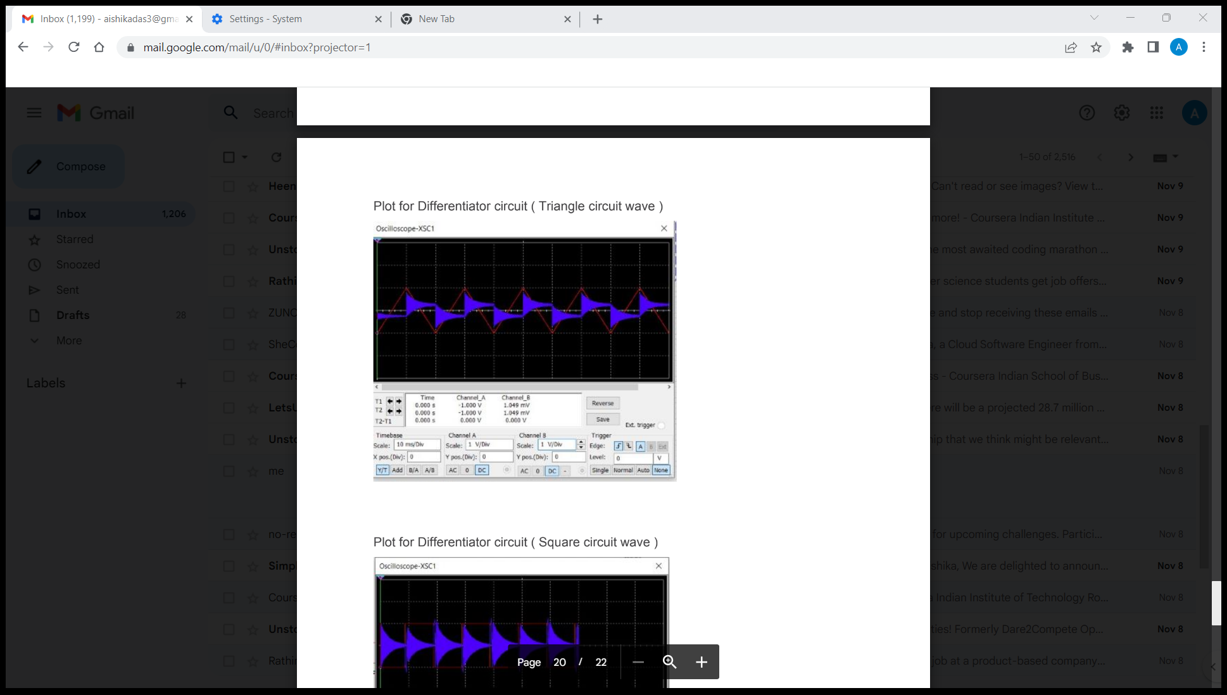
Stimulation(For triangular wave):

Slide 33
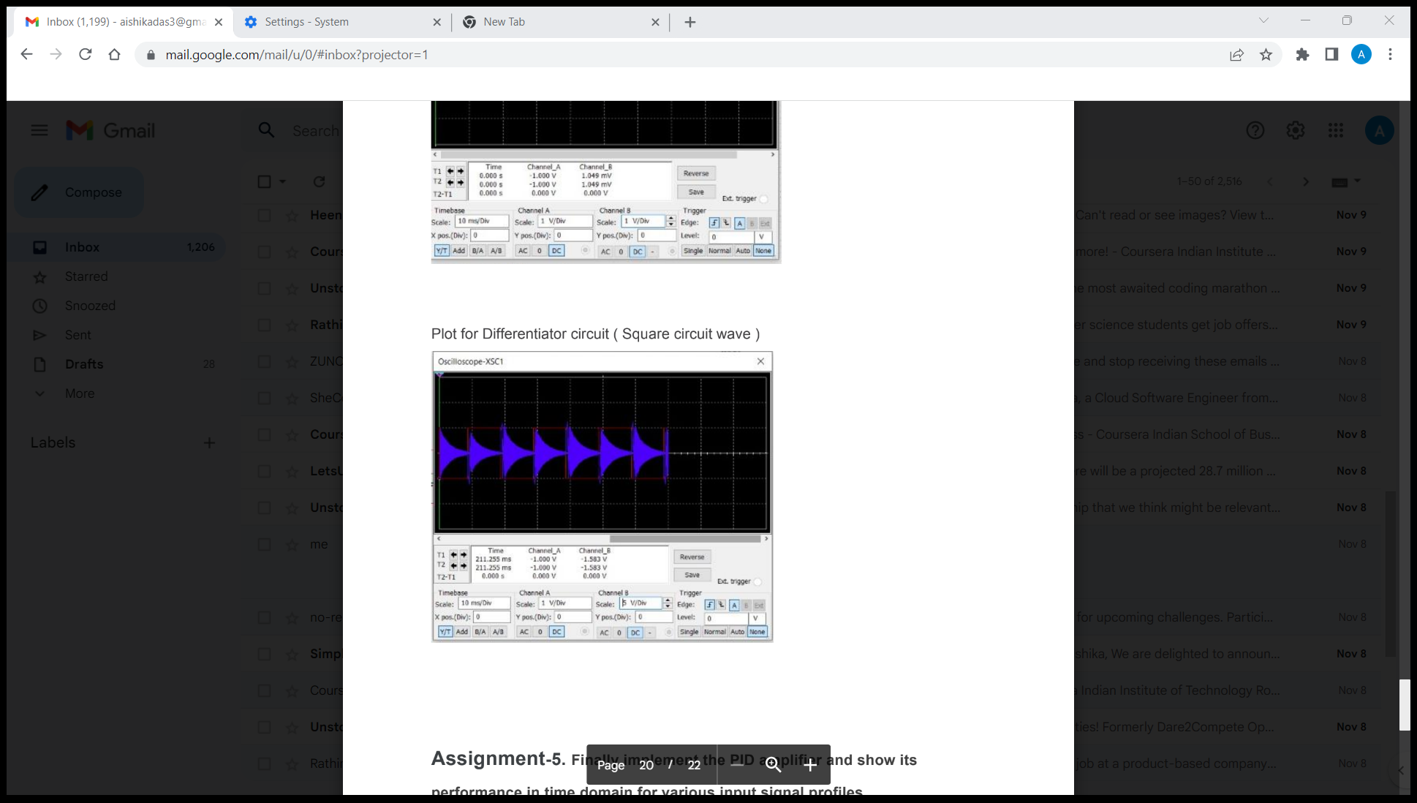
For stimulation(Square wave)

Slide 34
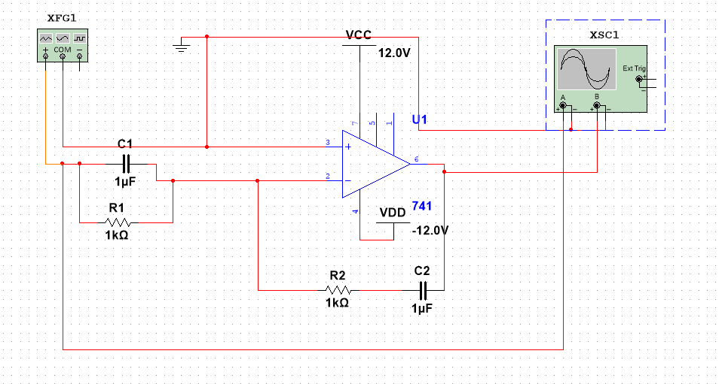
Part-E
Aim: Implement the PID amplifier and show its performance in the time domain for various input signal profiles.
Circuit:

Slide 35
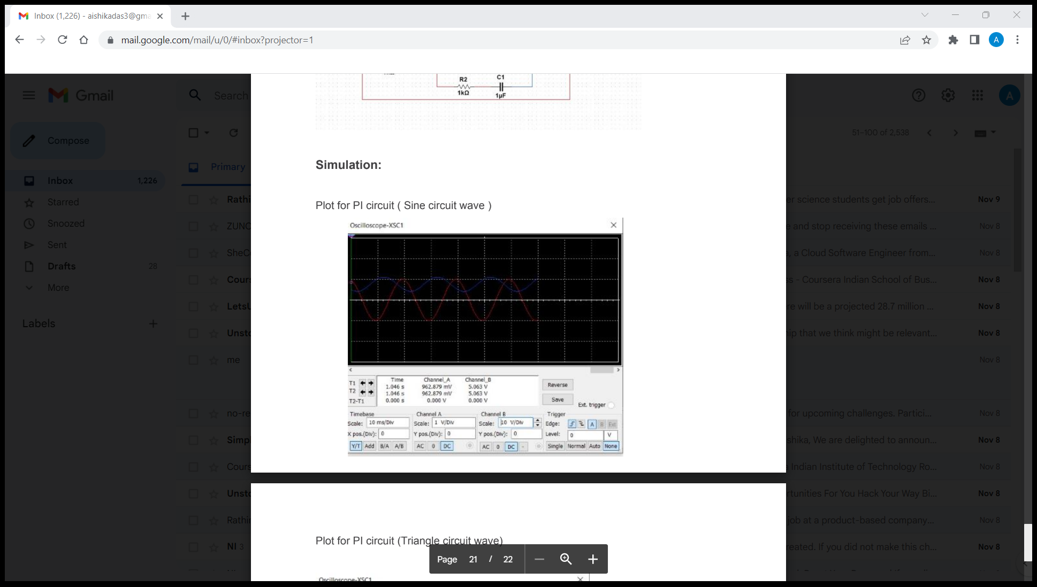
Stimulation(For sine):

Slide 36
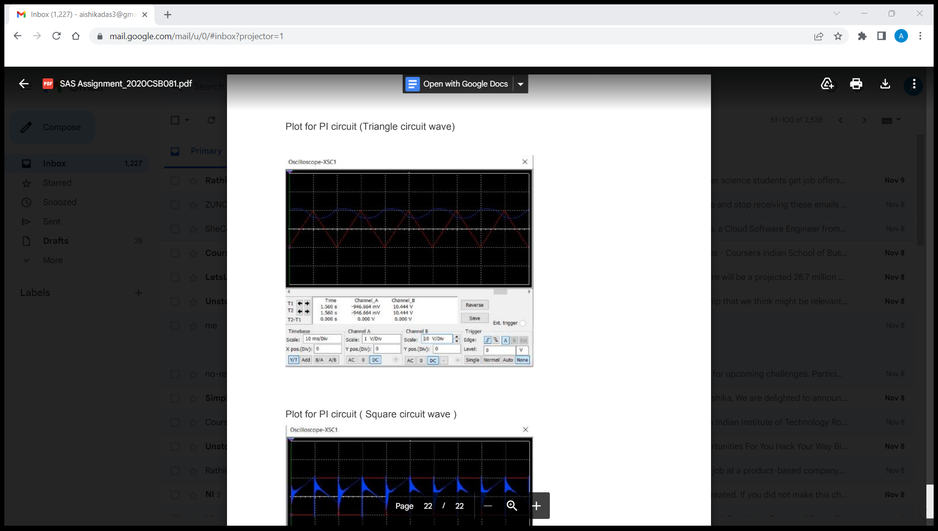
For triangular wave:

Slide 37
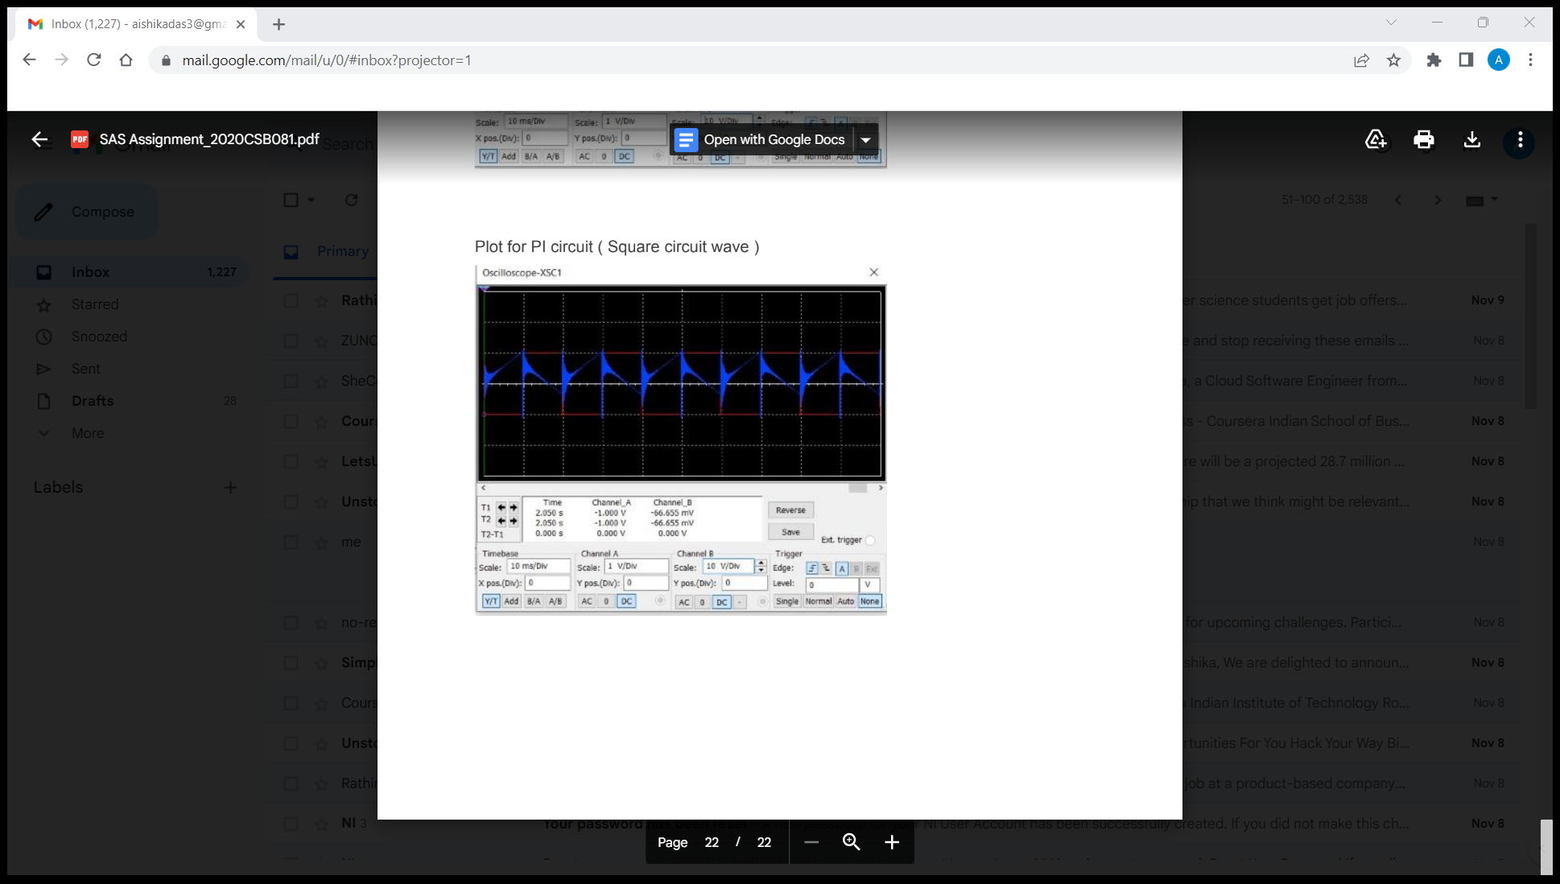
For square wave:

Slide 38
Theory:
PID stands for proportional, integral, and derivative in each application, coefficients of these three actions are varied to get optimal response and control.
y(t) ∝ ( e(t) + ∫e(t)dt + de(t)/dt )
y(t) = Kp*e(t) + ki ∫e(t)dt + Kp*de(t)/dt

Slide 39
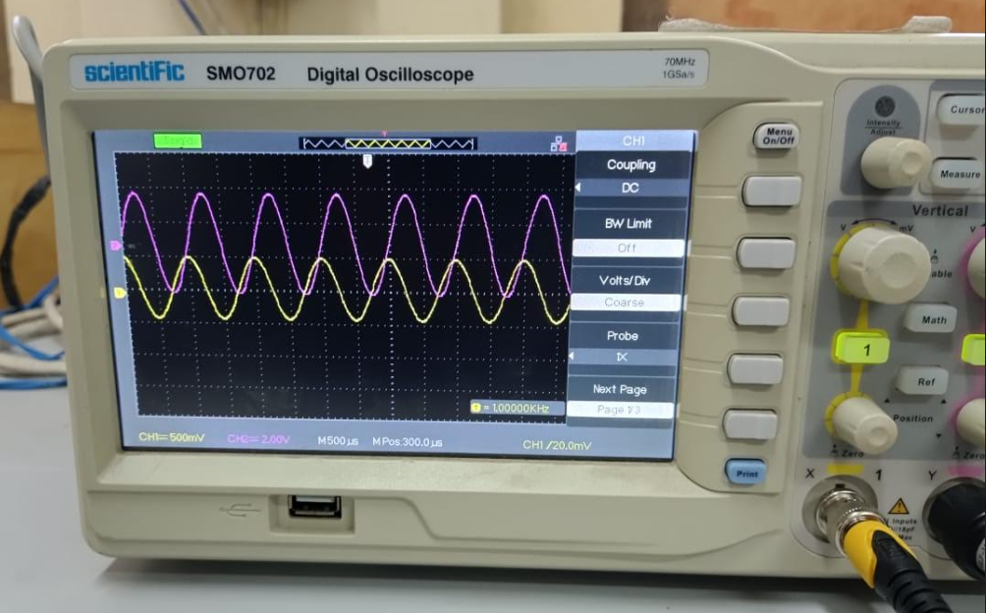
Outputs obtained from hardware lab:
For the implementation of a simple inverting amplifier:

Slide 40
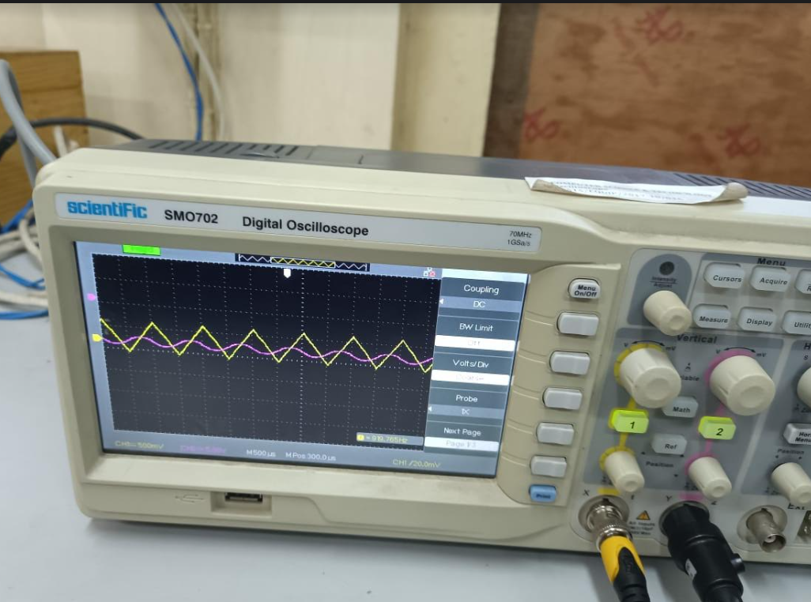
For integrator circuit implementation:

Slide 41
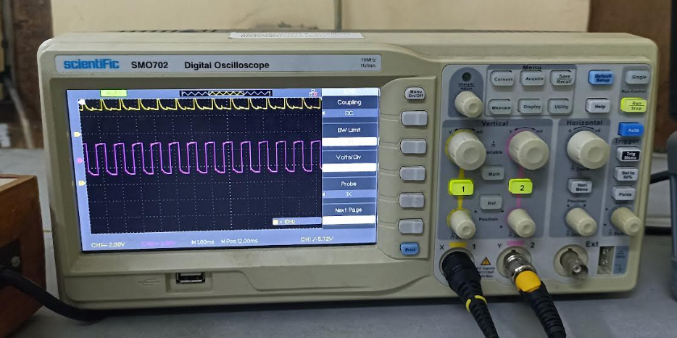
For differentiator circuit implementation:

